Slide 1
University of Hawaiʻi Cancer Center’s
Community Outreach
and Engagement Office
Kevin Cassel, DrPH
Faculty Director,
Associate Professor
University of Hawaiʻi Cancer Center
Healthy Hawaiʻi Strategic Planning Summit 2030
October 25, 2030

Slide 2
Community Outreach and Engagement Office
Purpose
Coalesce UHCC’s Community Research Collaborations
Structure and Evaluate the Impact of Activities
Identify and Address Disparities
Provide Venues for Community Inclusion in Cancer Research
Build Community Partnerships

Slide 3
Community Outreach & Engagement Team

Slide 4
Focus on Cancer Plan Objectives
OBJECTIVE CANCER-04
Increase by 20%, the proportion of adults who are diagnosed with cancer and participated in a cancer-related clinical trial.
OBJECTIVE CANCER-05
Increase by five, the number of schools that implement 1 to 2 of the recommended CDC Sun Protection Guidelines
.
OBJECTIVE CANCER-09
Increase the proportion of adults receiving lung, breast, cervical, and colorectal cancer screenings.

Slide 5
Projects – Tomosynthesis, Mammography Imaging Screening Trial (TMIST)
Objectives:
Randomized s clinical trial study comparing digital mammograms (2-D) with tomosynthesis mammograms (3-D)
Staff:
PI – Berenberg PD - Cassel CHE - Wakuk,
RAs – Kedi, Cornett
Populations: Micronesians, Togan, Rural
Cancer Focus: Clinical Trials, Breast Cancer Screening
Activities: Small Group Education (pre /posttests)
Period: 2020 -2023 Partners: Queens Healthsystem

Slide 6
TMIST
Knowledge Sample of Survey Items for Clinical Trials
A clinical trial can test a new medicine or treatment to see if it is safe.
In a clinical trial, a patient will always get the new medicine or treatment being tested.
The consent form explains the known risks of being in the clinical trial.
Once I sign a consent form, I must stay in the clinical trial until my doctor tells me I'm done.
Clinical trials of new medicines or treatments are carefully reviewed for safety
Clinical trials test whether a new medicine or treatment works.
Any medicine will have the same effect for all persons regardless of race or ethnicity.
Clinical trials help decide which doses of a medicine are best.
You can only join a clinical trial after you have tried all other options.
One possible benefit of participating in a clinical trial is getting new and possibly better treatments.
All the possible side effects of a new medicine being tested are known before the clinical trial starts.
Behavioral Propensity
I am likely to seek out information regarding clinical trials
I am likely to search for a clinical trial that I might be eligible for.
It is important for persons who belong to minority groups (persons of color) to participate in clinical trials.
I would consider talking to my doctor or healthcare provider about clinical trials that are right for me.
I am likely to join a clinical trial.
I am likely to talk to family/friends about joining a clinical trial.
13

Slide 7
TMIST
28 Clinical Trials Educational Sessions (2021- 2022)
Ethnicity | Attended
Asian | 167
NH/PI | 717
White | 50
Total Attendance | 934
Pre / Posttests Completed | 146
Joined TMIST Study | 15
Analysis of participants’ survey data indicated a significant increase (Chi-square p<.05) in knowledge (19 items) of clinical trials from pretest to posttest. Additionally, participants had a significant increase (Chi-square p<.05) in intent (5 items) to join a clinical trial
12

Slide 8
Initial TMIST Outreach Results
Accruals by Race Before vs After Community Outreach Project Initiated (n = 230)

Slide 9
2022 TMIST Outreach Results
We were able to maintain a high level of recruitments despite resurgence of COVID cases from
July to the present.
We kept in contact will potential
participants and maintained relationships with community partners including churches

Slide 10
Screen to Save: Colorectal Cancer Basics
Notes:
The National Colorectal Cancer Outreach and Screening Initiative, Screen to Save, focuses on colorectal cancer outreach and screening due to the disease’s prevalence and persisting disparities that affect underserved populations.

Slide 11
National Outreach Network (NON)
Community
Research Enterprise
(Cancer Centers)
Build and sustain a network
for education, outreach, and research engagement
to reduce cancer health disparities
in at-risk and underserved communities

Slide 12
Cancer that begins in the colon or rectum is called Colorectal Cancer (CRC)
CRC usually begins as a small growth (polyp)
in the linings of the colon or rectum.
Polyps and CRC are often symptomless.
Those who experience symptoms may have:
Persistent stomach pain or cramps
Blood in the stool
Feeling that your bowel does not fully empty
Changes in bowel habits or consistency of stool
Feelings of weakness or fatigue
Unexplained weight loss

Slide 13
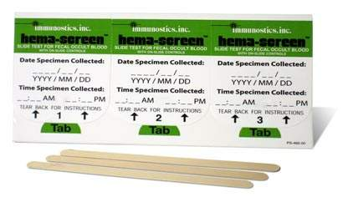
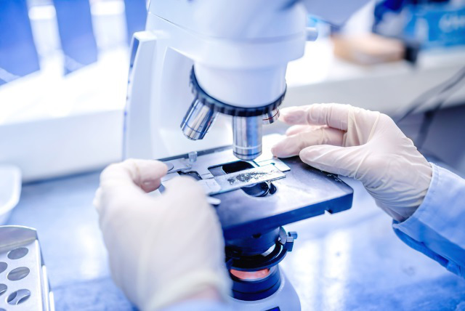
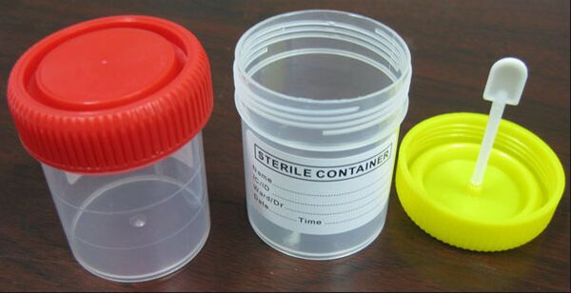
Home Kits: Screens for blood in stool
FOBT
Fecal Occult Blood Test
FIT
Fecal Immunochemical Test
Stool samples are collected in proper equipment provided in kit
Samples are returned to doctor or laboratory for testing
Recommended every year starting at age 50
Difference between the two is how the sample stool is collected. In FOBT,
the sample is placed on special cards and in FIT, it is placed on small vial.
Notes:
Unless you are experiencing the above symptoms earlier, you should begin cancer screening at the age of 50 until 75 years old.
If polyps are found early, your doctor can remove them before they turn into cancer.
Talk to your doctor about the best screening method for you.
Talk to your doctor about the costs and insurance coverage for the screening.

Slide 14
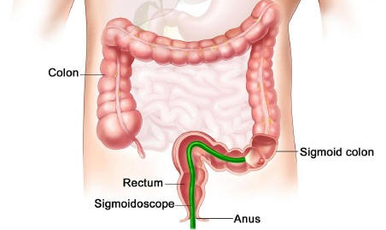
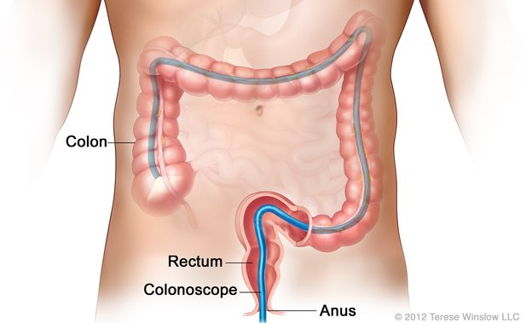
Screening by Medical Professional
Sigmoidoscopy
Colonoscopy
Procedure that examines the rectum and the lower (sigmoid) colon
A sigmoidoscope is a thin, tube-like instrument with a light and lens. It may also have a tool to remove polyps.
Recommended every 5-10 years
Procedure that examines the rectum and the entire colon
A colonoscope is a thin, tube-like instrument with a light and lens . It may also have a tool to remove polyps
Recommended every 10 years
Notes:
Cancer screening is looking for cancer before you have any symptoms.
Sigmoidoscopy is recommended every 5-10 years starting at the age of 50.
Colonoscopy is recommended every 10 years starting at the age of 50.
Show up for all screening appointments even if you don’t have any symptoms.

Slide 15
Ania iti Kanser ti Bagis?
Iti colon ket dakkel a bagis
Agsilpo ti kerret ken colon idiay ubet ken laonenna ti takki a maikkat ti bagi
Iti Kanser ti Bagis ket kanser nga agrugi idiay dakkel a bagis wenno kerret
Iti kanser ti bagis ket maikadua a gapu ti pakapatayan a kanser ditoy Estados Unidos
Nasurok a 150,000 a tao iti madayagnos ti CRC ditoy Estados Unidos maika-tawen
Nasurok a 50,000 a tao iti matmatay gapu iti CRC ditoy Estados Unidos maika-tawen
https://seer.cancer.gov/statfacts/html/colorect.html

Slide 16
Hawaii Department of Health Call and find out if you are eligible for free screening
Kalihi-Palama Health Center
915 N. King Street Honolulu, HI 96817
Phone: (808) 848-1438
Kalihi-Palama Health Center
89 S. King Street Honolulu, HI 96813
Phone: (808) 792-5560
Kapiolani Medical Center for Women and Children
1907 S. Beretania Street Honolulu, HI 96826
Phone: (808) 983-2016
Kokua Kalihi Valley
2239 N. School Street Honolulu, HI 96819
Phone: (808) 848-0976
The Queen’s Medical Center-Women’s Health Center
1301 Punchbowl Street Honolulu, HI 96813
Phone: (808) 691-7747
Waimanalo Health Center
41-1347 Kalanianaole Hwy. Waimanalo, HI 96795
Phone: (808) 259-7948
Waianae Coast Comprehensive Health Center
86-260 Farrington Hwy. Waianae, HI 96792
Phone: (808) 697-3594
Waipahu Family Health Center
94-428 Mokuola Street Waipahu, HI 96797
Phone: (808) 697-3882
Notes:
Note* CRC is preventable, treatable, and beatable.
For more information, please call the Cancer Information Service at 1-800-4-CANCER (1-800-422-6237)
Talk to your family, friends, and coworkers about CRC and what you have learnt today.
Talking about cancer will not cause cancer or bring it into our communities.

Slide 17
Screen to Save Data Collection
CHEs will collect and enter data whenever they use one of the primary outreach strategies
Pre-test: 14 items assessing knowledge of CRC, risk factors, and screening options and recommendations + 4 items to determine intentions to speak with a healthcare provider, get screened, and talk with family/friends about CRC; completed immediately after outreach activity
Post-test: knowledge assessment + 4 items to determine intentions to speak with a healthcare provider, get screened, and talk with family/friends about CRC; completed immediately after outreach activity
Follow-up survey
Conducted by phone 3 months after outreach
4 items to determine screening behavior and information sharing since receiving outreach
CHEs will assign unique identifiers to track changes in knowledge, intentions, and actions
Data integrated with the national data set

Slide 18
Outcomes
Community Educational Sessions by Topic, Demographic Characteristics 2021 to 2023
Screen to Save Educational Sessions = 36
Ethnicity | Attended (n)
Asian | 150
NH/PI | 334
White | 0
Filipino | 550
Total Attendance | 1034
Pre / Posttests Completed | 185

Slide 19
Outcomes
S2S CRC Pre/Posttest N= 97
Behavioral Change Questions | Pre-Education % Likely | Post-Education % Likely | Sig.*
I am likely to talk to a healthcare provider about CRC screening. | 78% | 95% | <.001
I am likely to get screened for CRC. | 75% | 92% | .001
I am likely to talk about CRC with family members or friends. | 79% | 96% | <.001
I am likely to eat healthier. | 85% | 96% | .006
I am likely to increase my physical activity. | 85% | 94% | .022

Slide 20
Hawaii Primary Care Clinic Monitoring Data
Health Center | 2016 |  | 2017 |  | 2018 |  | 2019 |  | 2020 |  | 2021 |  | 2022
FQHC STATE TOTALS
Colorectal Cancer |  |  | 11403 | 37.83% | 12178 | 39.06% | 13402 | 42.31% | 12616 | 39.76% | 13678 | 40.74% | 12,244 | 37.21%
Kalihi Palama Health Center
Colorectal Cancer | 2,400 | 63.01% | 2,824 | 67.38% | 2,710 | 64.05% | 3,026 | 70.18% | 2,849 | 66.39% | 3,097 | 63.39% | 1,720 | 40.90%
Kokua Kalihi Valley Comprehensive Family Services
Colorectal Cancer | 731 | 55.05% | 483 | 42.93% | 638 | 46.50% | 515 | 42.99% | 492 | 30.92% | 594 | 40.24% | 615 | 41.61%
Waianae District Comp Hlth & Hospital Board
Colorectal Cancer | 1,429 | 26.82% | 1,422 | 25.37% | 1,804 | 31.06% | 2,042 | 33.31% | 1,634 | 29.70% | 1,968 | 36.29% | 2,239 | 37.35%
Waikiki Health
Colorectal Cancer | 1,072 | 38.22% | 1,035 | 41.10% | 1,023 | 35.25% | 1,114 | 38.33% | 1,051 | 34.98% | 1,080 | 34.24% | 1,109 | 33.63%
Waimanalo Health Center
Colorectal Cancer | 363 | 44.32% | 438 | 50.34% | 443 | 49.11% | 527 | 54.39% | 531 | 48.14% | 541 | 52.12% | 557 | 53.35%

Slide 21
Projects
Objectives:
To spread skin cancer awareness to the public in Hawaii through community venues. Fact sheets and sunscreen samples are to be distributed to those who stopped by the exhibits in hopes of educating the community on the importance of sun protection.
Staff:
PI – Le Marchand PD – Cassel
CHE – TBN
Populations: Residents, tourists, parents
Partners: Friends of the UH Cancer Center, Hawaii Skin Cancer Coalition, Hawaii Comprehensive Cancer Coalition, Hawaii Dermatological Society, JABSOM DIGS
Skin
Van
Period: 2023 - 2025

Slide 22
Questions?

